Slide 2
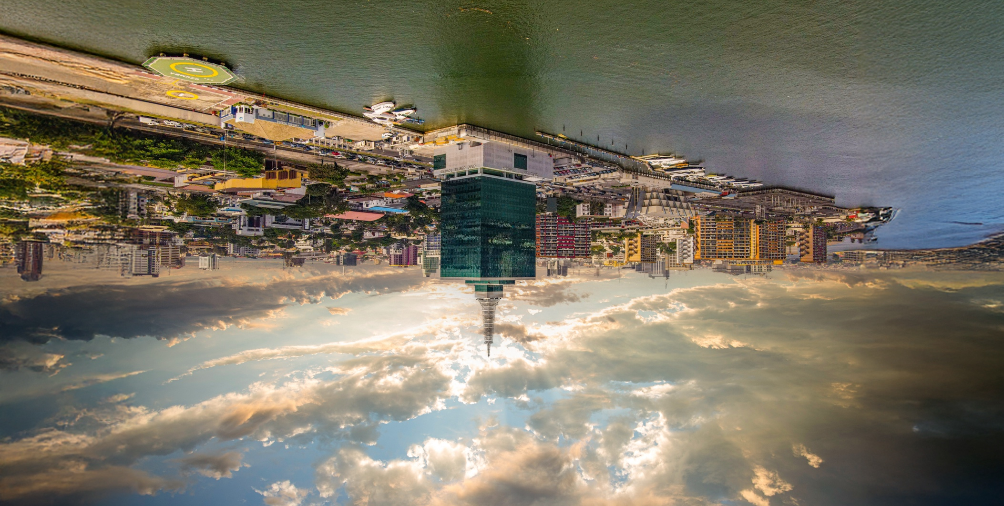


I’m speaking at
WHX Labs Lagos 2025
Join me

